Slide 1


ENGINEERING: SIMPLE MACHINES

Slide 2
Introduction to
Simple Machines

Slide 3
Simple machines are machines with few or no moving parts that are used to make work easier
What are they?
Photos should be a
square like this.

Slide 4
Types of Simple Machines
Wedge
Wheel and Axle
Lever
Inclined Plane
Screw
Pulley

Slide 5
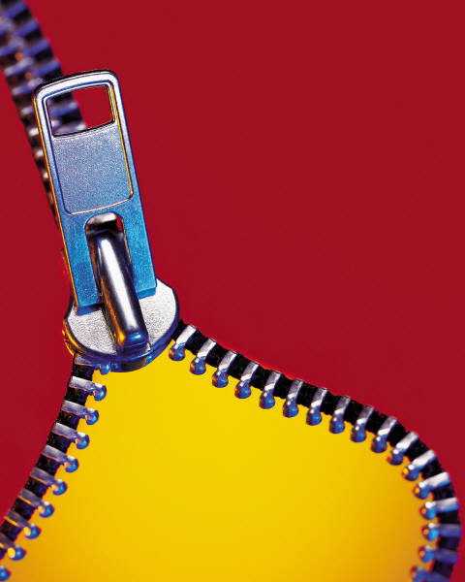
Wedge
Pushes materials apart, cuts things
Examples: axe, doorstop, chisel, nail, saw, jackhammer, bulldozer, snow plow, horse plow, zipper, scissors, airplane wing, knife, fork, bow of a boat or ship

Slide 6
Wheel and Axle
Makes it easy to move things by rolling them, and reducing friction
Examples: car, bicycle, office chair, wheel barrow, shopping cart, hand truck, roller skates

Slide 7
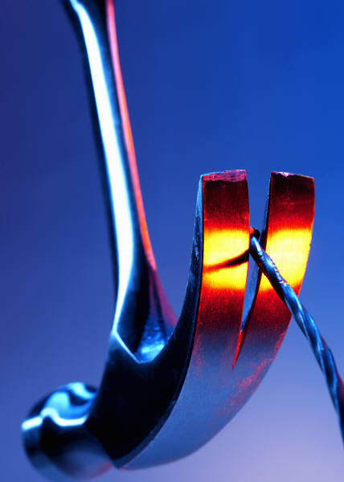
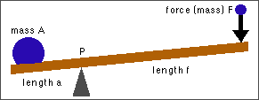
Lever
Makes lifting weight easier by using a fulcrum to redirect force over a longer distance
Examples: see-saw, dump truck, broom, crane arm, hammer claw, crow bar, fishing pole, screwdriver, bottle opener

Slide 8
Inclined Plane
Makes it easier to move objects upward, but you have to go further horizontally
Examples: highway or sidewalk ramp, stairs, inclined conveyor belts, switchback roads or trails

Slide 9
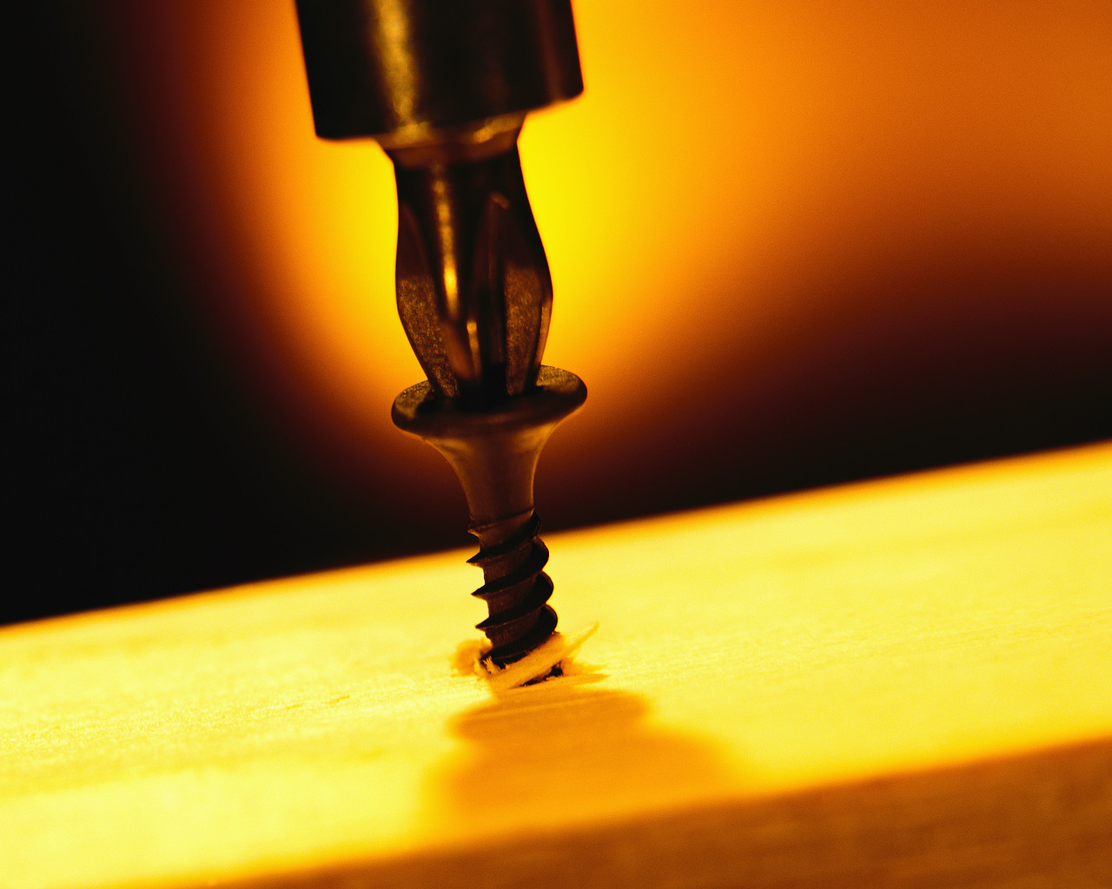
Screw
Turns rotation into lengthwise movement
Takes many twists to go a short distance
Holds things together
Examples: screws, bolts, clamps, jar lids, car jack, spinning stools, spiral staircases

Slide 10


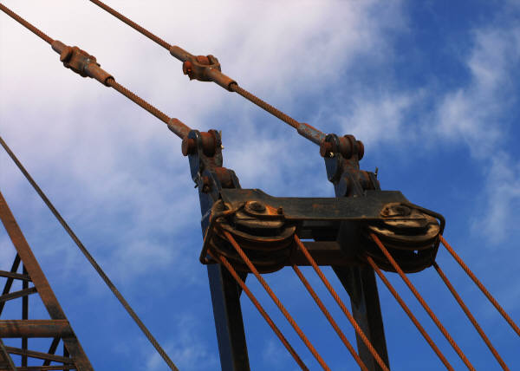
Pulley
Makes lifting things with a rope easier by redirecting force and the addition of additional pulleys
Examples: flag pole, elevator, sails, fishing nets, clothes lines, cranes, window shades and blinds, rock climbing gear

Slide 11
Why Use Simple Machines?
For the mechanical advantage…
Making something easier to do, but it takes a little longer to do it
For example, going up a longer flight of stairs instead of going straight up a ladder

Slide 12
Complex Machines
Combining two or more simple machines to work together
Examples:
Car jack combines wedge and screw
Crane or tow truck combines lever and pulley
Wheelbarrow combines wheel and axle with a lever

Slide 13
Summary
Wedge | Pushes material apart, cuts
Wheel and Axle | Makes it easy to move things by rolling them, and reducing friction
Lever | Helps lift heavy weights using longer distances
Inclined Plane | Makes it easier to move objects upward; a longer path, but easier lifting
Screw | Turns rotation into lengthwise movement
Pulley | Makes lifting heavy weights easier by redirecting force

Slide 14
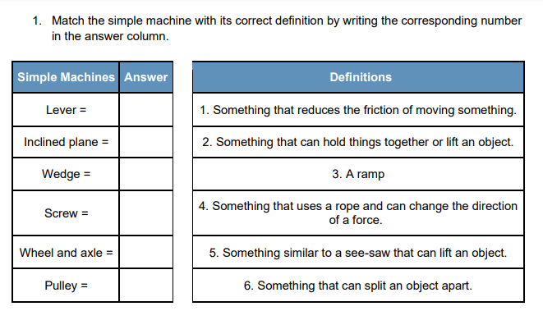

Slide 15
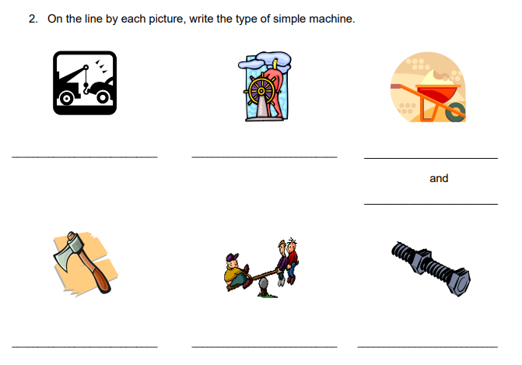

Slide 16
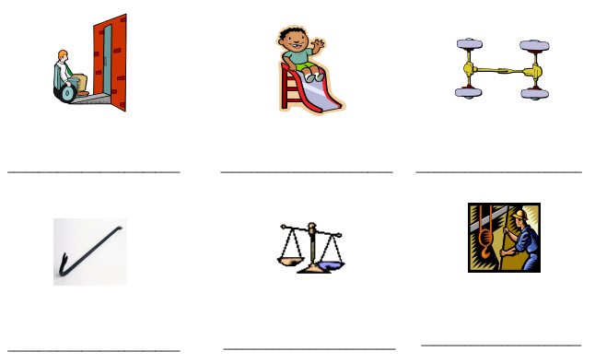

Slide 17
References
All images © Copyright © 2004 Microsoft Corporation, One Microsoft Way, Redmond, WA 98052-6399 USA. All rights reserved.
Except for image below, which was created by the ITL Program, College of Engineering and Applied Science, University of Colorado at Boulder.

